Slide 1

Community Police Officers:
A Kid’s Guide to What We Do
Adapted from “Portland Police Bureau: A Kid’s Guide to What We Do” by Officer Dave Thoman and Molly Thoman Walker.

Slide 2
What is a Community Police Officer?
A community police officer is a person who works with people to solve problems. They help keep your city a safe place and protect people from crime.

Slide 3
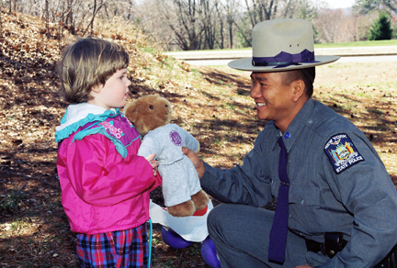
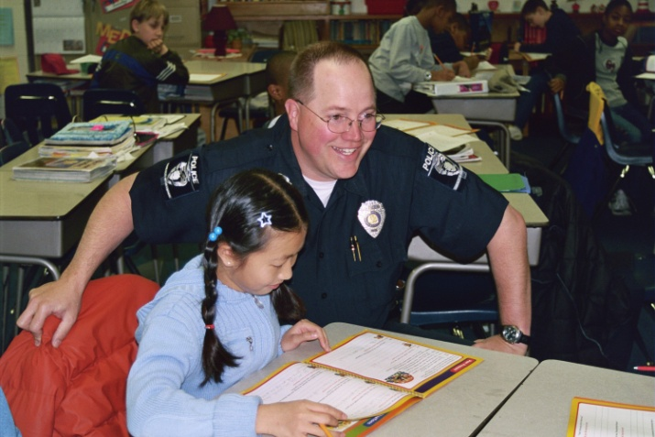
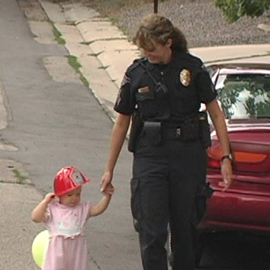
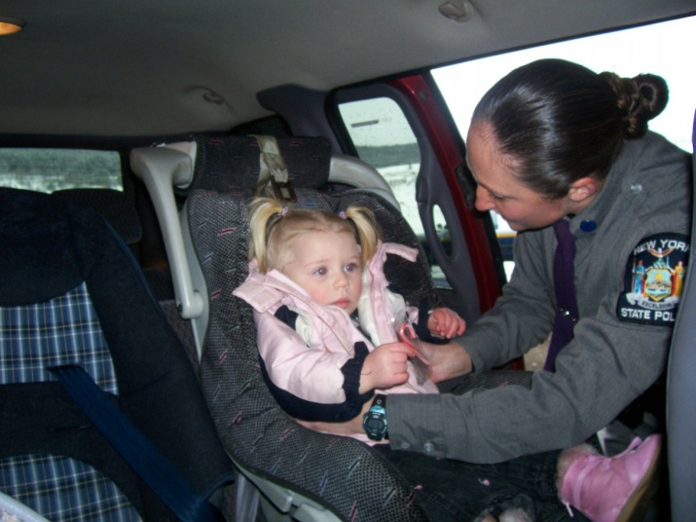
Did you know?
Police departments serve their communities in many other ways.

Slide 4
Who can be a Community Police Officer?
Police departments have different rules for who can be a community police officer. Usually, you have to be at least 21 years old and have graduated from high school or have gone to college.
You can ask your local police department what their rules are for becoming a community police officer.

Slide 5
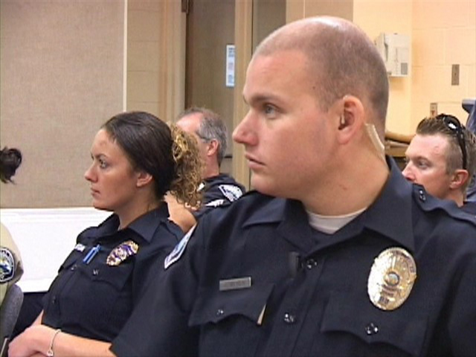
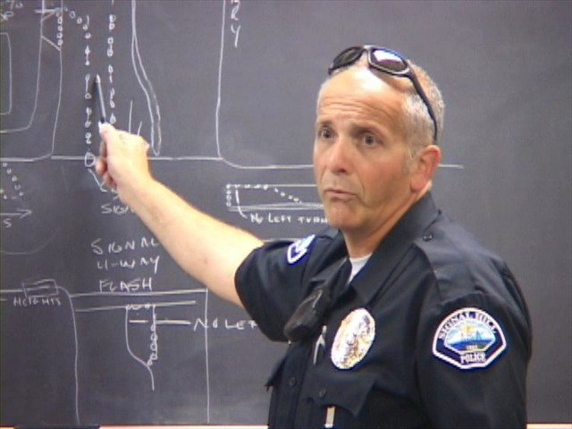
Did you know?
Police officers meet every day before they start work. This meeting is called roll call.

Slide 6
What Training Does a Police Officer Have to Complete?
Police officers must attend a special kind of school called an academy.
Depending on the department type and where the department is, there are different kinds of classes officers must attend.
After police officers graduate from the academy, they will ride with an experienced officer who will help them learn more before they can work by themselves.

Slide 7
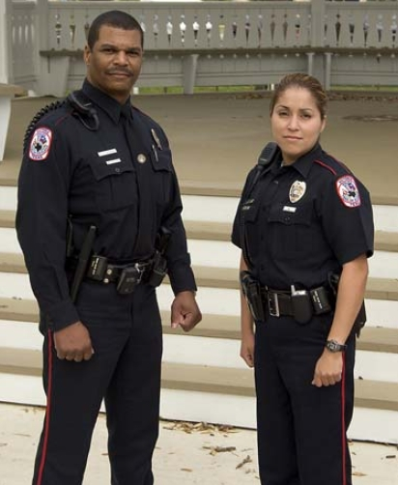
What Tools Do Police Officers Use?
Did you know?
A police officer’s duty belt and body armor weighs about 28 pounds!
Most police officers wear a uniform and a badge. Different types of officers wear different uniforms. Police officers carry their tools on a duty belt. They also wear body armor under their uniforms for protection.

Slide 8
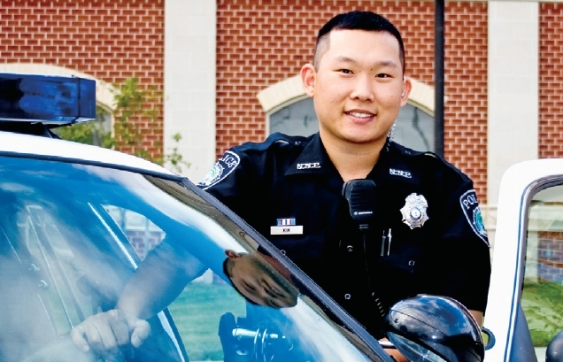
What Do Community Police Officers Do?
Community police officers watch over neighborhoods and talk to people in the community. They answer radio calls from dispatchers and sometimes take people to jail.

Slide 9
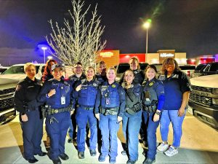
There are many types of police officers. Let’s explore some of the different jobs police officers do!

Slide 10
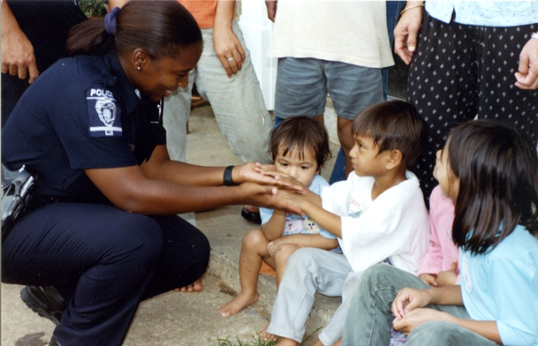
SCHOOL RESOURCE OFFICERS
School resource officers watch over schools and help keep students safe. School resource officers help students and teachers solve problems. The officers also sometimes train safety patrol students.

Slide 11
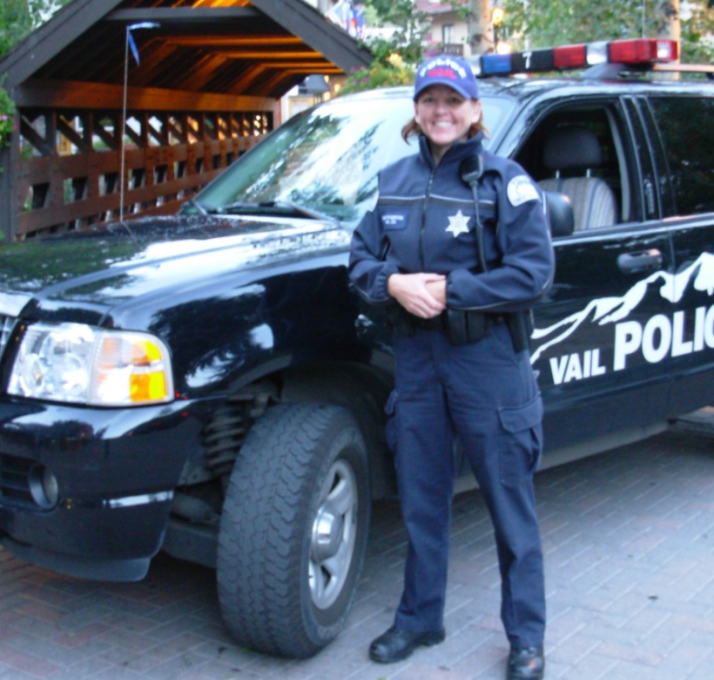
TRAFFIC OFFICERS
Traffic officers make sure people drive safely. They use cars and motorcycles to do their job. Traffic officers also investigate car crashes.

Slide 12
BIKE OFFICERS
Some officers ride bikes to patrol their city or town.

Slide 13
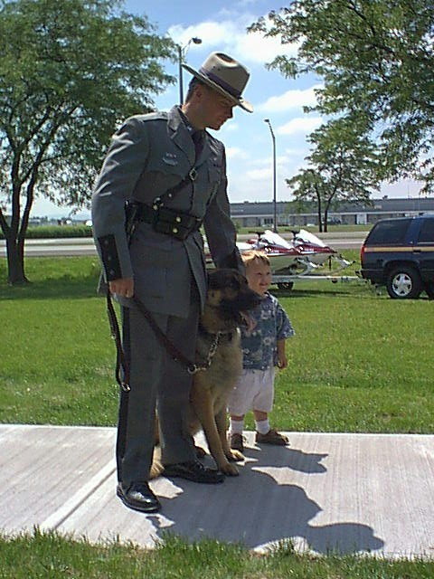
K9 OFFICERS
A K9 officer has a dog for a partner. The dogs use their sense of smell to find things. K9 officers and their dogs go through very special training.
Did you know?
The dog lives at home with the officer and officer’s family.

Slide 14
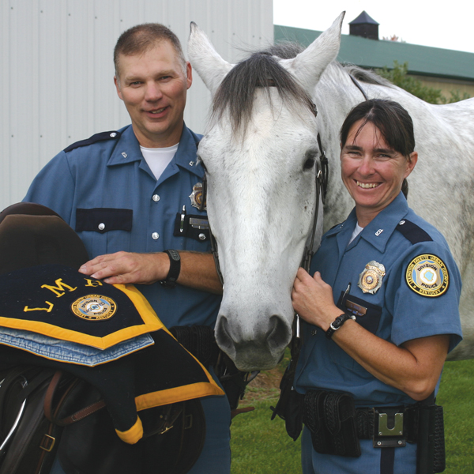
MOUNTED PATROL
Mounted patrol officers ride horses. The officers and horses get special training to do police work.
Did you know?
If the horse poops on the sidewalk, the officer scoops it.

Slide 15
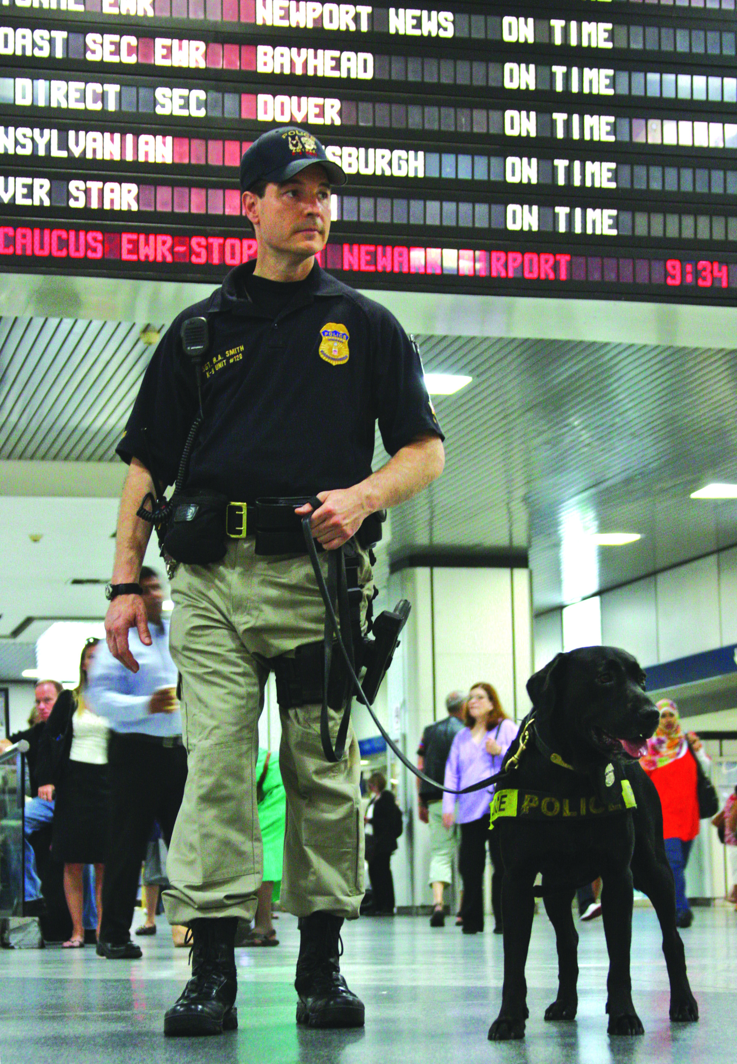
TRANSIT POLICE OFFICERS
Transit police officers patrol trains and buses. They also keep the bus stops and platforms safe.

Slide 16
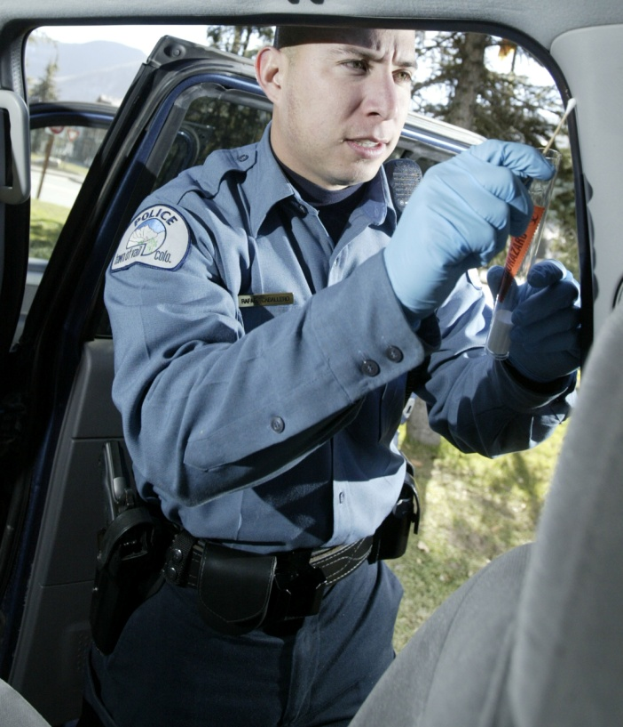
CRIMINOLOGISTS
Criminologists take pictures at crime scenes. They collect fingerprints and evidence to help solve crimes.
Did you know?
No one has the same fingerprint as you!

Slide 17
DETECTIVES
Detectives investigate crimes. They interview people to find out what happened. Detectives usually do not wear uniforms or drive patrol cars.

Slide 18
Who Helps Police Officers?
Many people work in police departments who are not officers.
They take care of lost or stolen property, help people who come into police stations, keep track of reports, and do many other jobs. They help police officers by making sure they have the right tools and information to do their jobs.

Slide 19
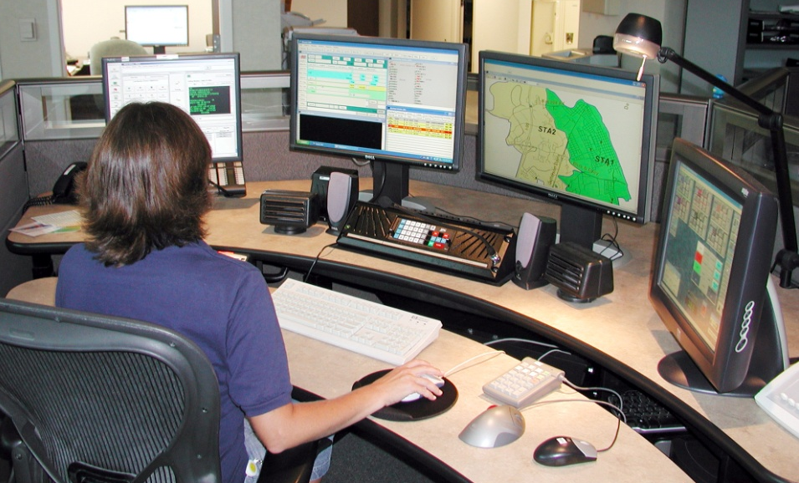
What Happens When I Call 9-1-1?
When a person calls 9-1-1, a dispatcher answers the phone. The dispatcher types all the information from the caller into the computer and calls police officers on the radio. The dispatcher tells the police officers where to go and who needs help.

Slide 20
Tips to Help Keep You Safe
Always make sure your parents know where you are.
You can call 9-1-1 from any phone if there is an emergency.
Memorize your address, phone number, and your parents’ names.
Always wear a fastened helmet when you’re riding a bicycle, skateboard, or scooter.
Don’t talk to strangers, take anything from them, or go anywhere with them.
Cross the street only at corners or crosswalks and look both ways before you cross.
If you see a gun or weapon, STOP. Don’t touch it. Get away and tell an adult.

