Slide 1

The Law enforcement oath of honor
Adapted from the Law Enforcement Oath of Honor Video produced by IACP and LETV.
View the video here: http://www.youtube.com/watch?v=uUDczg27Fl4&feature=share&list=UUY6ahcARglFVAkevrgtBNcg

Slide 2
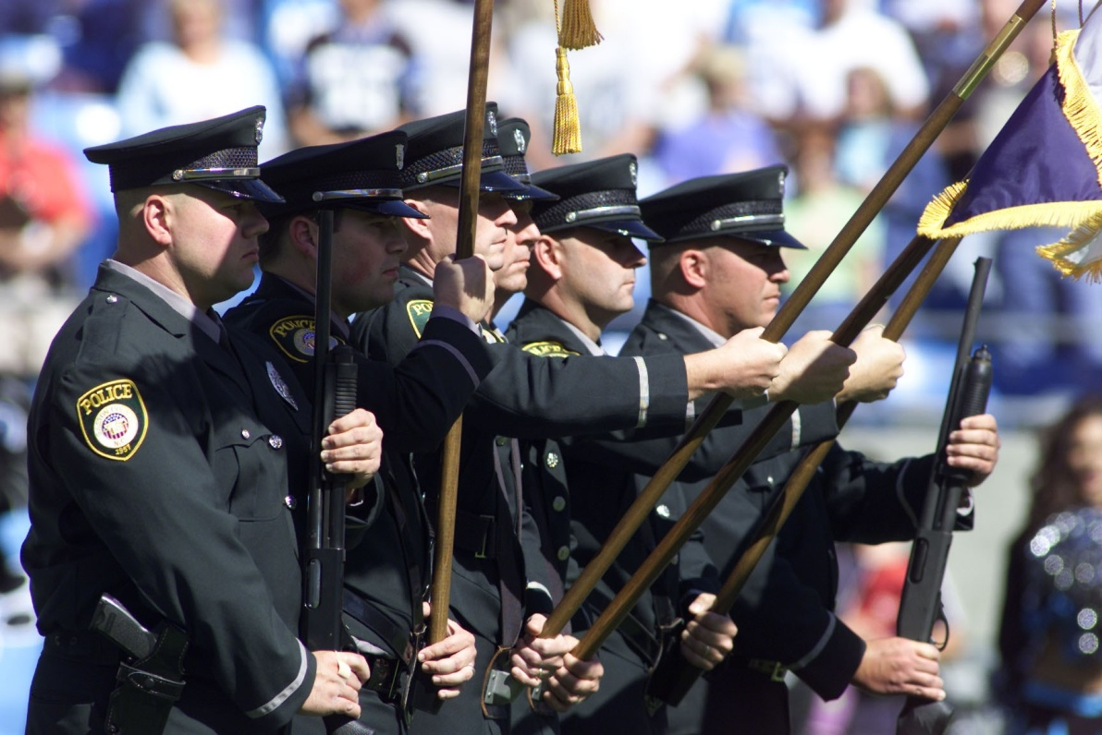
There is a reason why many communities refer to the police as “Our Finest.”

Slide 3
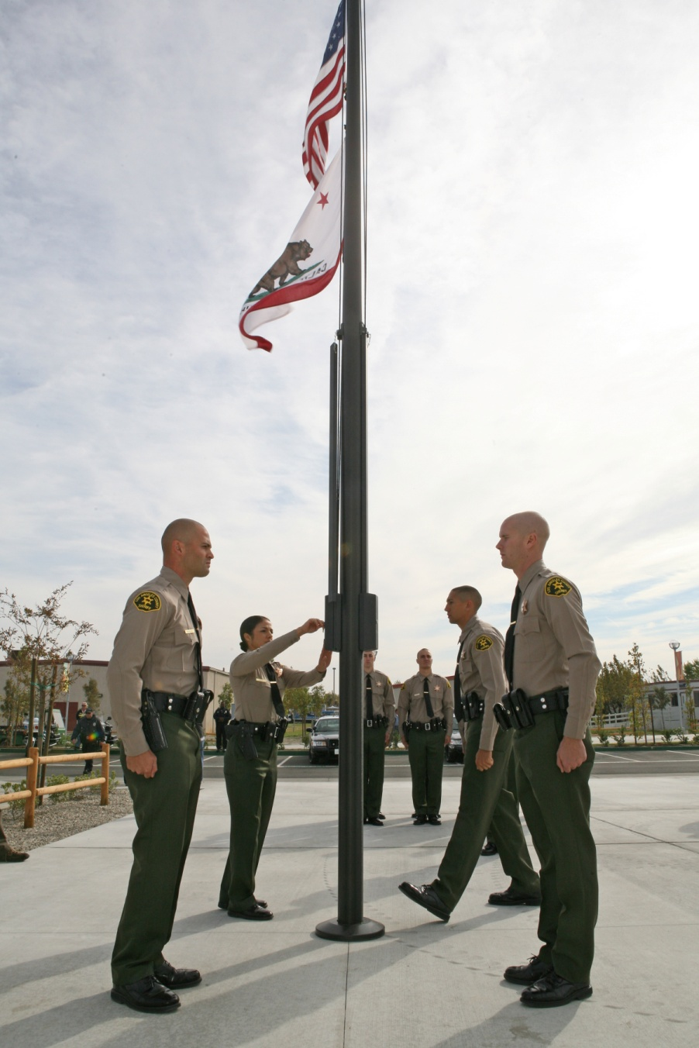
Standards should and must be higher for the individuals given the authority and responsibility of a sworn officer.

Slide 4
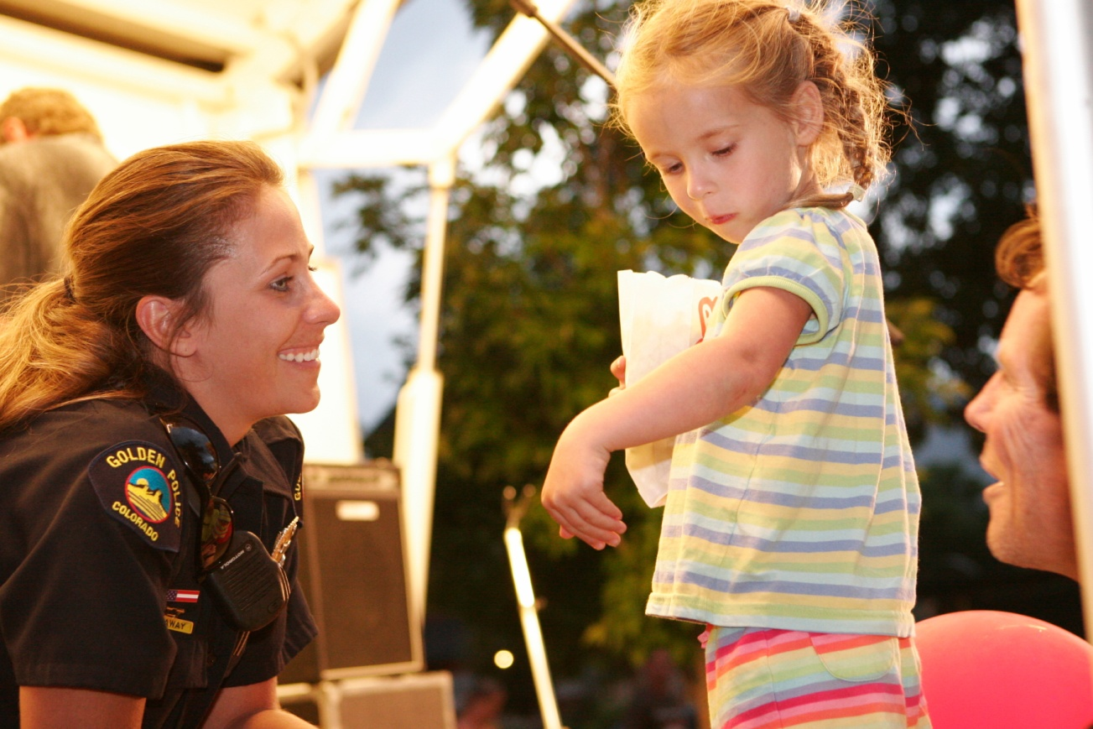
Police Officers should willingly accept the responsibility to be a role model for ethical behavior.

Slide 5
Key words in the oath of honor

Slide 6
HONOR
Giving one’s word as a bond or guarantee

Slide 7
betray
A violation of loyalty and proving trust to be false

Slide 8
integrity
Firm adherence to moral and ethical principles in both public and private life

Slide 9
character
The qualities and standards of behavior that distinguish an individual from others

Slide 10
Public trust
The confidence imposed in those who are sworn to fairly serve their communities

Slide 11
courage
Having the mental and moral strength to venture forth, persevere, withstand, and overcome danger, difficulty, and fear

Slide 12
Accountability
Being responsible and answerable for our own actions

Slide 13
community
The people of the jurisdiction that we serve

Slide 14
Oath of honor
On my honor, I will never betray my integrity,
my character, or the public trust.
I will treat all individuals with dignity and respect
and ensure that my actions are dedicated
to ensuring the safety of my community
and the preservation of human life.
I will always have the courage to hold myself
and others accountable for our actions.
I will always maintain the highest ethical standards
and uphold the values of my community,
and the agency I serve.

Slide 15
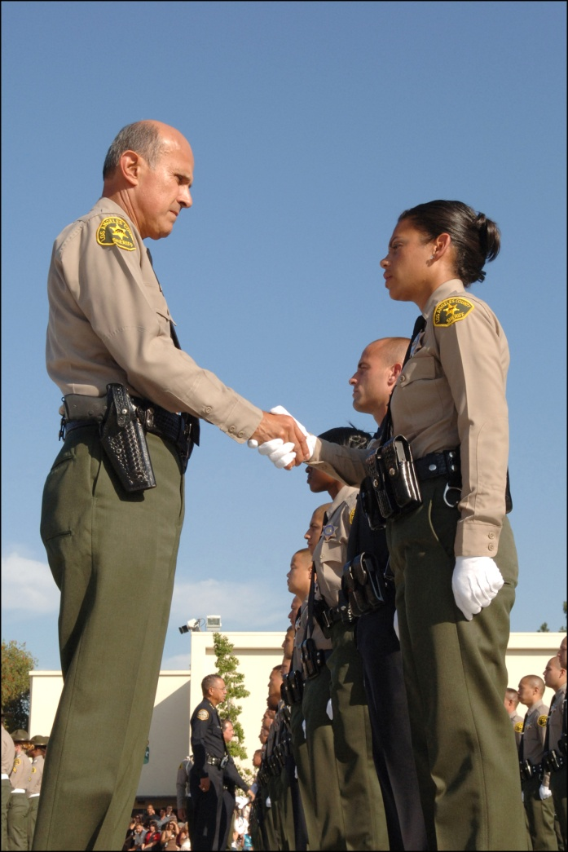
To learn more about policing visit
www.discoverpolicing.org

