Slide 1

Discovering a Career in Policing

Slide 2
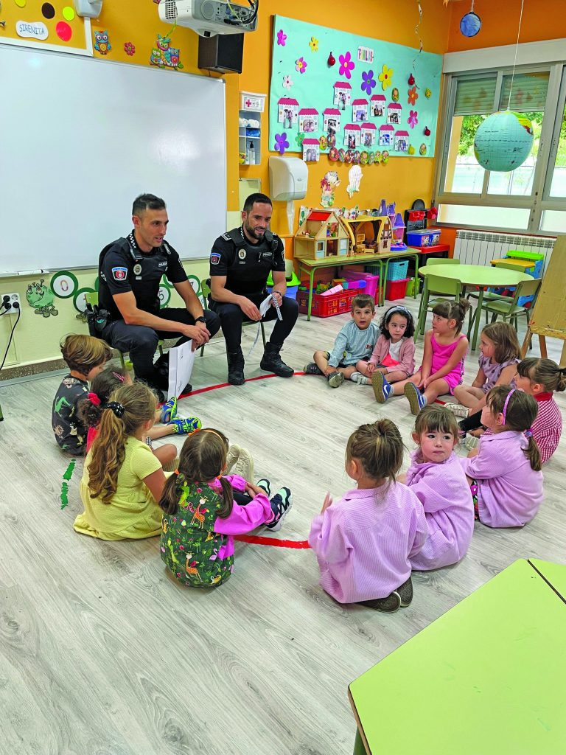
Why Policing?
More than just a job, policing is a service career.
Police officers come from all walks of life.
New challenges and numerous opportunities.
Qualified officers are in demand.
Good salary and benefits.

Slide 3
Types of Police Agencies
Federal
State – state patrols, state bureaus of investigation
Local – city police, county sheriffs, regional agencies, tribal police
Special – school system police, transit agency police, harbor or marina police

Slide 4
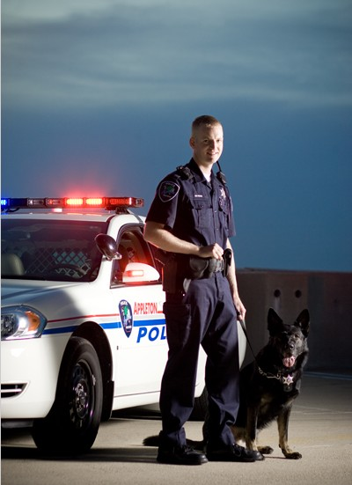
Types of Jobs
Sworn
Patrol Officer (bicycle or mounted patrol)
Investigator
SWAT Team Member
A sworn position is one that is managed the by the state POST (Peace Officer Standards and Training). Individuals in these positions typically carry a badge and a firearm and have arrest authority.

Slide 5
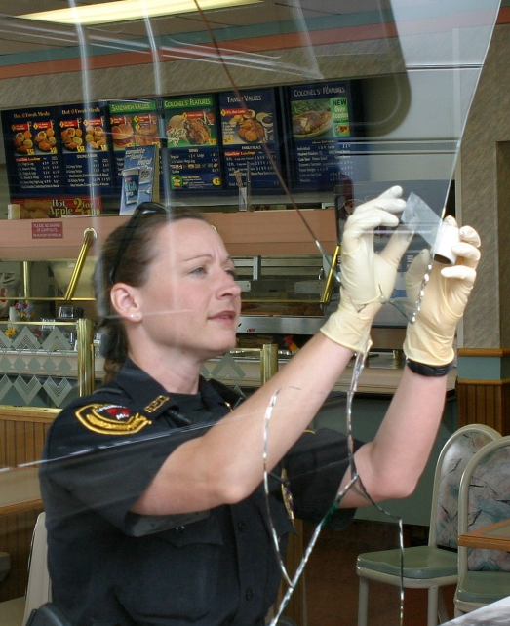
Types of Jobs
Civilian
Crime Prevention Specialist
Crime Analyst
Public Information Officer
Civilian positions usually have a specified scope and role with specialized skills. These individuals do not carry firearms or have arrest powers.

Slide 6
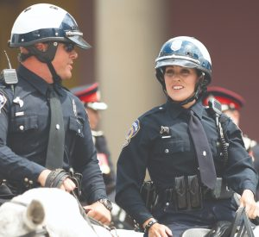
What Does It Take? Basic Requirements
Each state sets standards that all agencies must meet or exceed.
Types of requirements:
Citizenship
Residency (depending on agency)
Minimum/Maximum age
Education
Valid Drivers License
Fitness
Be aware of disqualifiers as well.

Slide 7
What Does It Take? Skills and Abilities
Problem-solving and critical thinking skills
Ability to multi-task
Capacity for empathy and compassion
Ability to demonstrate courage and take responsibility
Able to work collaboratively
Languages and cultural responsiveness
Procedural justice and impartial policing
Mental health awareness

Slide 8


What Does It Take? The Hiring Process
Application
Entrance Exam (written or video)
Physical Fitness and Agility Test
Background Investigation
Drug Testing
Psychological and Medical Exams
Polygraph
Interview
Medical Exam

Slide 9
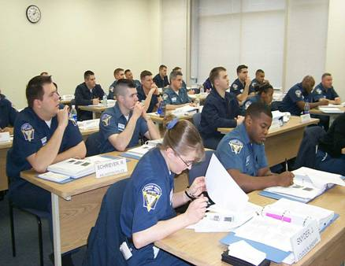
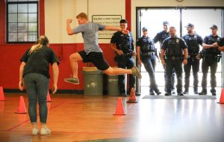
What Does It Take? Training
Academy Training
Each jurisdiction has different requirements.
Involves a variety of topics such as:
Operations
Weapons/defensive tactics
De-escalation/use of force
Legal education
Mental & physical health
Field Training
After completing the academy, a final field training component will pair you with a training officer to accompany on routine patrol.

Slide 10
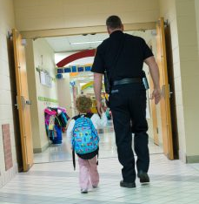
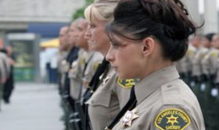
To learn more about a career in policing, visit
www.discoverpolicing.org

